Slide 1
EnergyPlus 8.2
Getting Started in Command Line

Slide 2
Installation
On MacOS
  Apply the dmg package at
    http://apps1.eere.energy.gov/buildings/energyplus/register.cfm?goto=eplus
  Or download from my shared link
    https://drive.google.com/file/d/0Bzn8tD_Jzg_qbURvcDY2dkR5anM/view?usp=sharing

Slide 3
Installation cont’d
After installation, some commands are available:
  EnergyPlus
  EPMacro
  runenergyplus // we use this for CLI testing
Type in terminal to verify
  runenergyplus

Slide 4
EnergyPlus Dir Hier on Mac
/Application/EnergyPlus-8.x.y/
  ExampleFiles/
    Example *.idf files, describes sample buildings
  WeatherData/
    Example *epw files, describes weathers at some example locations
  Documentation/
  . . .
We use *.idf and *.epw to do the simulations

Slide 5
Run EnergyPlus
Prepare IDF file and EPW file
  Using WindACAuto.idf to describe building
    Copied from /Applications/EnergyPlus-8-2-7/ExampleFiles/WindACAuto.idf
  Using USA_CA_San.Francisco.Intl.AP.724940_TMY3.epw to describe weather
    Copied from /Applications/EnergyPlus-8-2-7/WeatherData/USA_CA_San.Francisco.Intl.AP.724940_TMY3.epw

Slide 6
Run EnergyPlus cont’d
Command format
  runenergyplus InputFileName [WeatherFileName]
In this example
  runenergyplus WindACAuto.idf USA_CA_San.Francisco.Intl.AP.724940_TMY3.epw
Generate directory “Output/”

Slide 7
Output files
Temperature data appears in WindACAuto.csv
  Can be imported into excel (choose comma as delimiter)
And many other files
  .svg – HVAC diagram
  .mtr – raw report meter output
  .err – list of errors and warnings
  And more… (see GettingStarted.pdf, page 14)

Slide 8
Plot sample from WindACAuto.csv

Slide 9
IDF files
Describes everything related to the building
  Wall materials and structure
  Exposure to sunlight
  Zone-based-
    Floor plan definition
    Electric equipment, HVAC
    Occupancy
Output specification

Slide 10
EPW (EnergyPlus Weather) files
Historical weather data
Used for provide environmental weather conditions for simulation

Slide 11
Preprocessor and Postprocessor
EngeryPlus usually works as simulation engine for Sketchup and Openstudio
Sketchup can be used to design and construct the building
Openstudio can be utilized to set the conditions inside the building and generate reports.

Slide 12
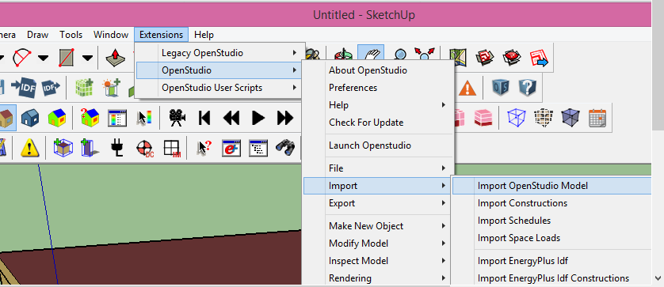
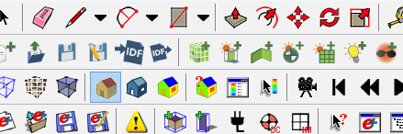
Sketchup
The file type of Sketchup are .skb and .osm, can open Energyplus .idf file and Openstudio .osm file.
Import Openstudio file:
Import EngergyPlus file:

Slide 13
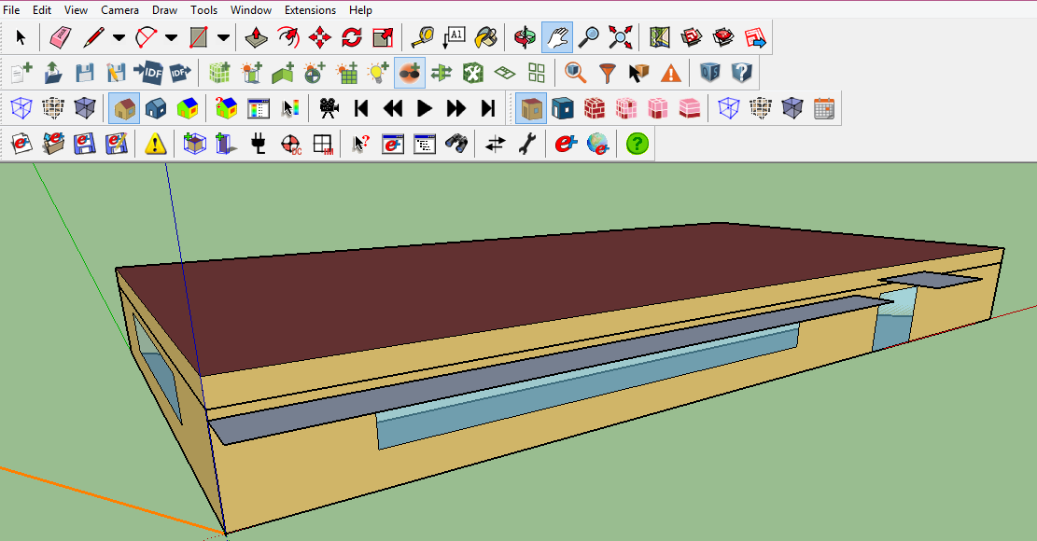
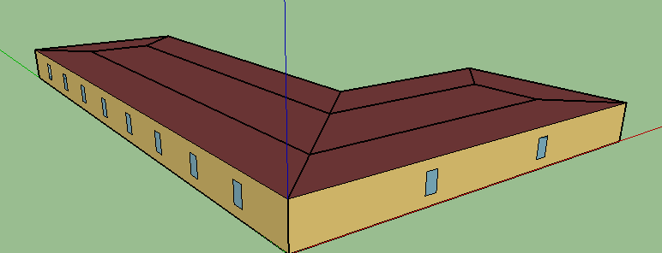
An example in Sketchup
A house with roof, wall, window and shades:

Slide 14

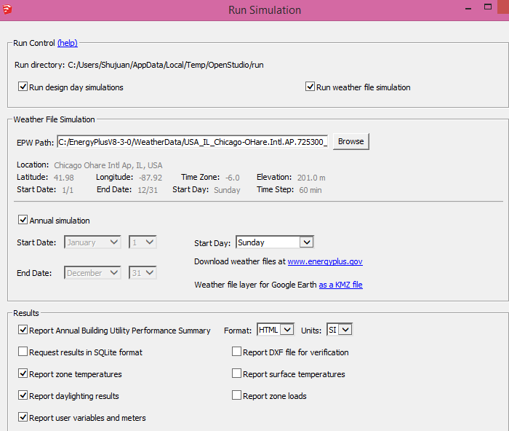
Run EnergyPlus in Sketchup
Choose this option will run EnergyPlus in the Sketchup
Choose the .epw weather file

Slide 15
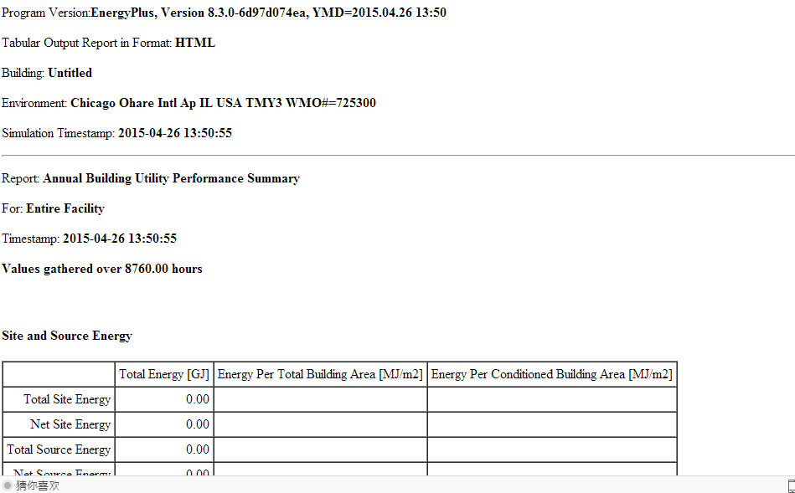
Generate Report

Slide 16
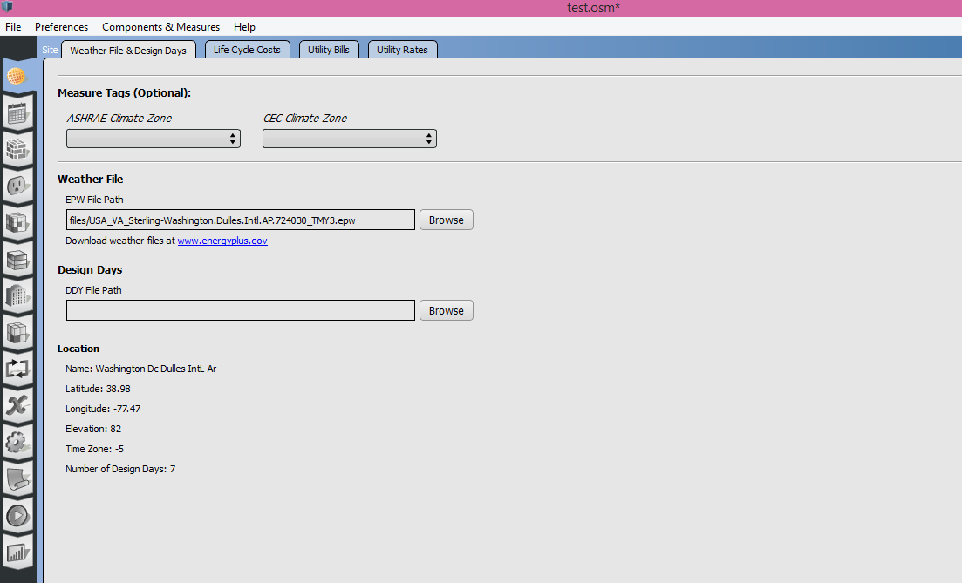
Openstudio
The file type of Openstudio is .osm file.
Openstudio Interface
First, need to input the weather .epw file and Design days .ddy file

Slide 17
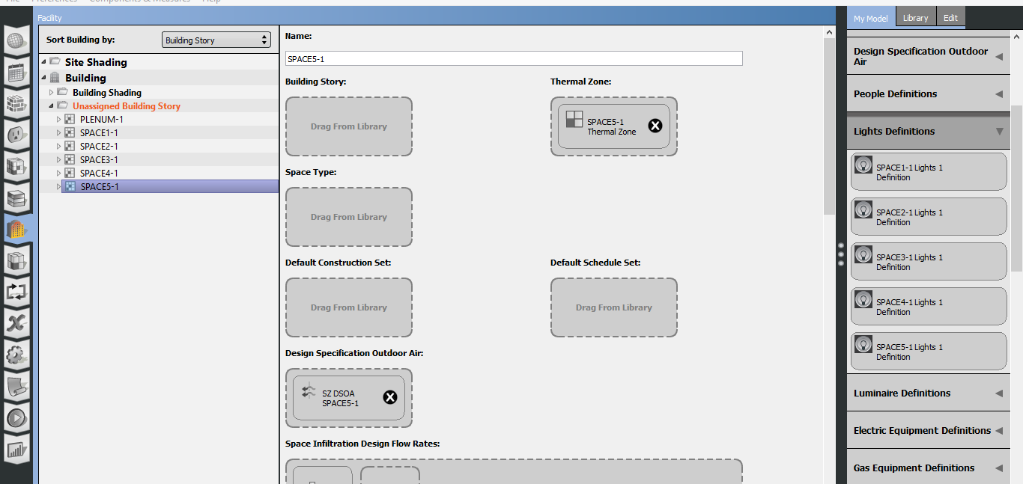
Setting for each thermal zone

Slide 18
Setting for each thermal zone
The setting includes:
Thermal Zones
Space Type
Schedule
Outdoor Air
People
Lights
Electric Equipment
Gas Equipment
Water Use Equipment
Surfaces
Etc.

Slide 19
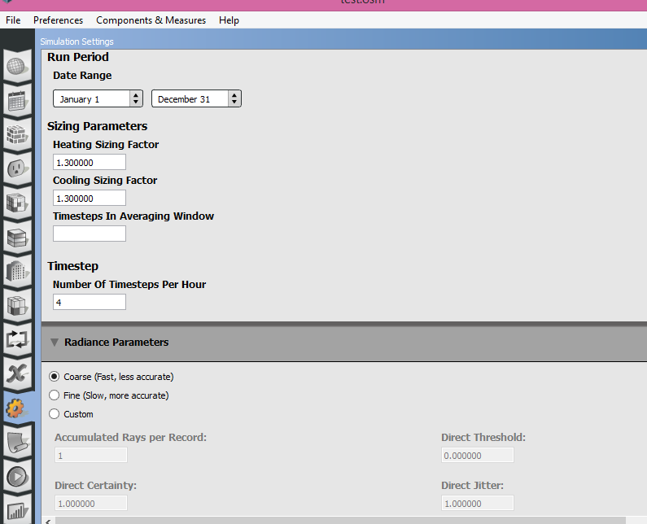
Setting for the simulation
Choose the convergence limits and convergence algorithm in the setting.

Slide 20
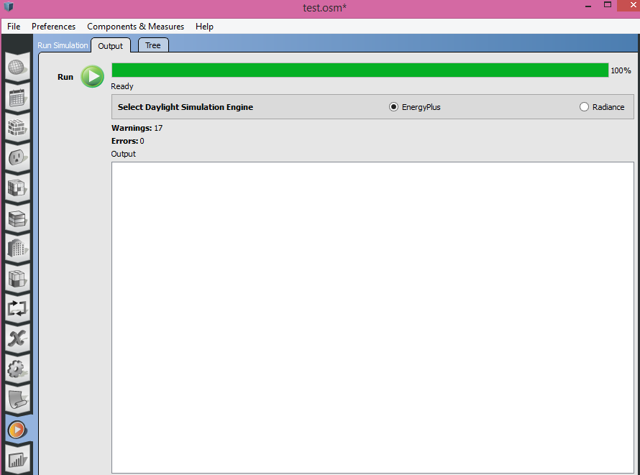
Run the model

Slide 21
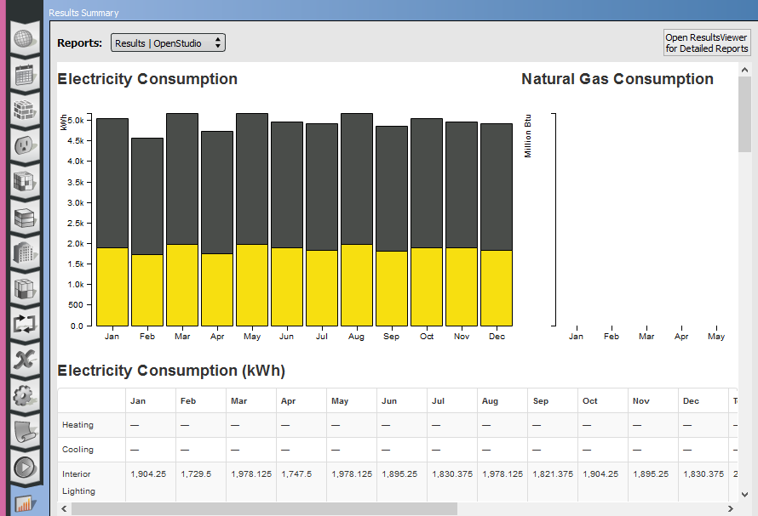
Result
Use this to get more results

Slide 22
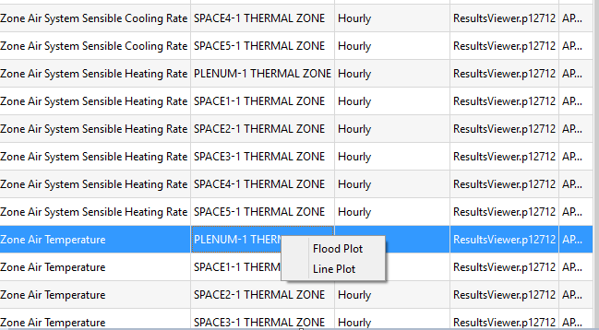
Result
Use Flood Plot or Line Plot:

Slide 23
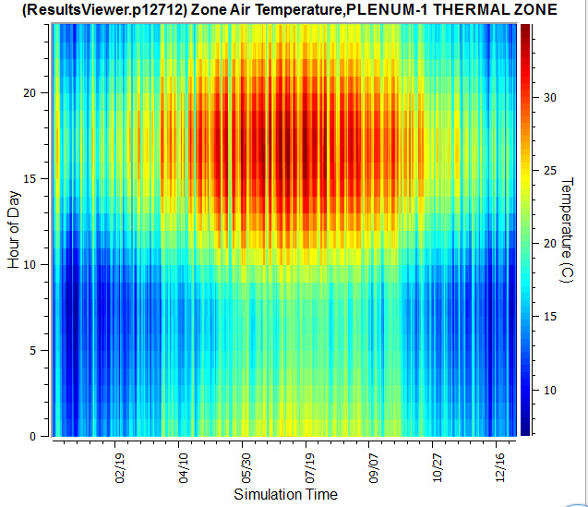
Flood Plot:

Slide 24
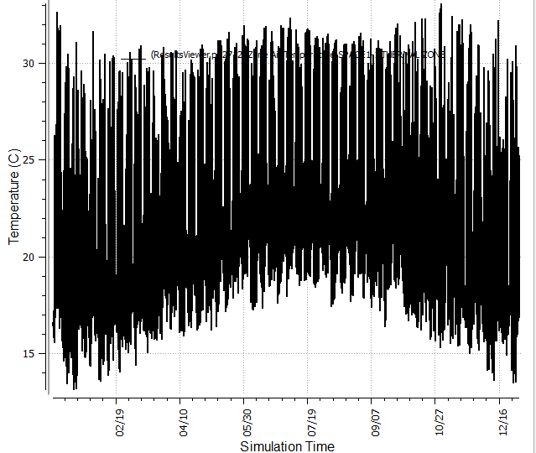
Line Plot:

